Slide 1
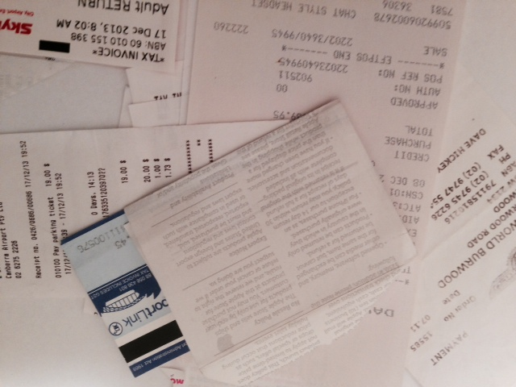
Ken Mansell
ken@taxrambling.com
taxrambling.com
Small Business Restructures & Super

Slide 2
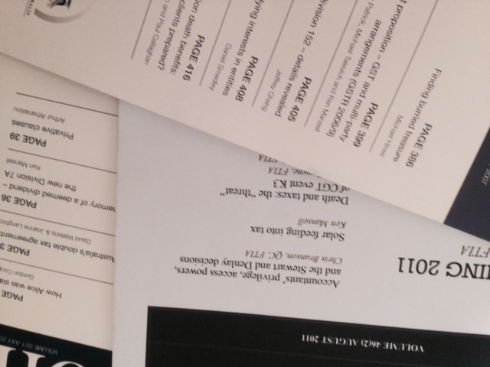
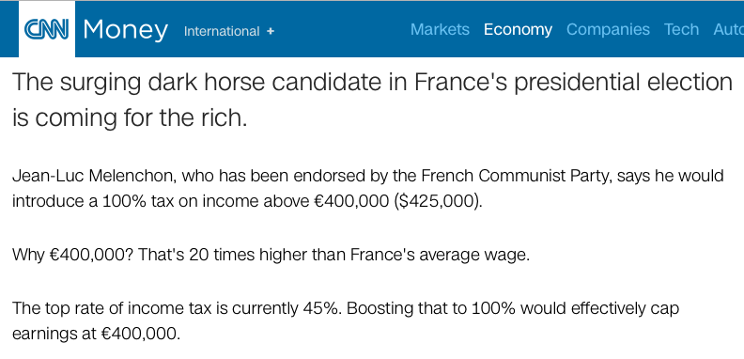
  And you thought we had it bad
Notes:
Tips:
The New Slide button is on the Standard toolbar.
You can also click Insert>New Slide.

Slide 3
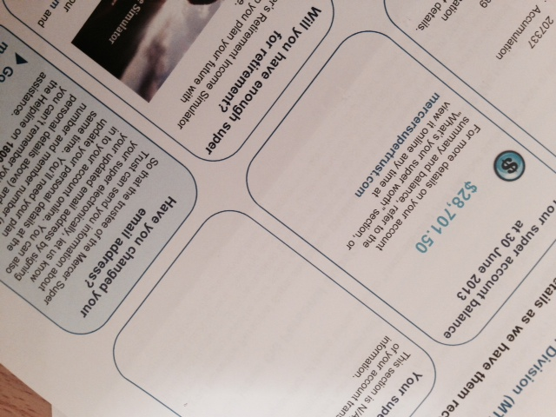
  Setting up a business
  Start cheap and nasty
  Causes problems
  No asset protection, bring in new equity, income splitting and the CGT concessions
  Solve by either…
  SBCGT or Restructure Rollover
  Which is better?
  Which is better given recent super changes?
Notes:
Tips:
If you don’t see the Formatting Palette, click View>Formatting Palette.
To make changes to the picture, you first have to select the picture.

Slide 4
  Case Study
  Chris and Victoria are husband and wife and are the only shareholders in Puppy Co, with each owning one share with a cost base of $2 per share.
  Puppy Co has successfully carried on a puppy training school and has acquired significant assets including puppy boarding facilities, a vehicle, and goodwill.
  The boarding facilities have a cost base of $250,000 and have a market value now in the range of $500,000 to $700,000. It was purchased 12 years ago. There is still a $50,000 mortgage on the boarding facilities in the name of the company but with a guarantee from Chris and Victoria.
Notes:
Tips:
If you don’t see the Formatting Palette, click View>Formatting Palette.
To make changes to the picture, you first have to select the picture.

Slide 5
  Case Study
  The goodwill has a cost base of $50,000 as the company purchased the business 12 years ago. There have been people interested in buying the business previously, including discussions 2 years ago with a key employee to buy the business for $100,000 and lease the premises from Chris and Victoria.
  Chris and Vicky take a salary each week of $250 each ($13,000 each a year) and the rest of any profit is paid as a dividend each quarter. These dividends are generally around $15,000 to $20,000 each year for each shareholder (grossed up).
Notes:
Tips:
If you don’t see the Formatting Palette, click View>Formatting Palette.
To make changes to the picture, you first have to select the picture.

Slide 6
  Case Study
  So the company tax return has a taxable income of say $34,000 (on which $10,100 is paid in company tax) and each individual tax return has $13,000 salary, a $17,000 grossed up dividend, with a $5,100 imputation credit.
  Chris is 53 and Victoria is 56. They have one child, Joshua, who is going to be a perpetual university student and has just started his 6-year PHD.
  Chris and Victoria has an SMSF and it holds listed shares worth $4 million (each has an interest of $2 million).
Notes:
Tips:
If you don’t see the Formatting Palette, click View>Formatting Palette.
To make changes to the picture, you first have to select the picture.

Slide 7
  What structure do we want?
  Equity investment?
  Asset protection?
  Income Splitting?
  CGT Concessions?
  Super?
Notes:
Tips:
If you don’t see the Formatting Palette, click View>Formatting Palette.
To make changes to the picture, you first have to select the picture.

Slide 8
  Restructure Rollover
  1 July 2016
  Subdivision 328-G creates an optional rollover where a small business entity transfers an active asset of the business to another small business entity as part of a genuine business restructure, without changing the ultimate economic ownership of the asset
Notes:
Tips:
If you don’t see the Formatting Palette, click View>Formatting Palette.
To make changes to the picture, you first have to select the picture.

Slide 9
  Restructure Rollover
  Genuine restructure?
  A bona fide commercial arrangement to enhance business efficiency;
  Where a business continues, through a different entity structure but under the same ultimate economic ownership;
  Where the transferred assets continue to be used in the business;
Notes:
Tips:
If you don’t see the Formatting Palette, click View>Formatting Palette.
To make changes to the picture, you first have to select the picture.

Slide 10
  Restructure Rollover
  Genuine restructure?
  Where the restructure results in a structure likely to have been adopted had obtained appropriate professional advice when setting up the business;
  Where the restructure is not artificial or unduly tax driven;
  Where the restructure is not a divestment or to facilitate the economic realisation of assets
Notes:
Tips:
If you don’t see the Formatting Palette, click View>Formatting Palette.
To make changes to the picture, you first have to select the picture.

Slide 11
  Restructure Rollover
  LCG 2016/3
  Examples include asset protection, equity investments and simplifying a business structure. However, it does not include succession planning or restructuring just to extract wealth.
  There is a safe harbour
Notes:
Tips:
If you don’t see the Formatting Palette, click View>Formatting Palette.
To make changes to the picture, you first have to select the picture.

Slide 12
  Restructure Rollover
  Can we get to our proposed structure through a genuine restructure?
Notes:
Tips:
If you don’t see the Formatting Palette, click View>Formatting Palette.
To make changes to the picture, you first have to select the picture.

Slide 13
  Restructure Rollover
  Small Business Entity
    $10 million
  Ultimate Economic Ownership
    DT and FTEs
  Active Assets
  Federal taxes only
    Stamp duties
  Division 7A
  Discount and 15 year exemption
  Pre CGT
  SMSF and residency
Notes:
Tips:
If you don’t see the Formatting Palette, click View>Formatting Palette.
To make changes to the picture, you first have to select the picture.

Slide 14
  Restructure Rollover
  Can we get to our proposed structure through the rollover restructure?
Notes:
Tips:
If you don’t see the Formatting Palette, click View>Formatting Palette.
To make changes to the picture, you first have to select the picture.

Slide 15

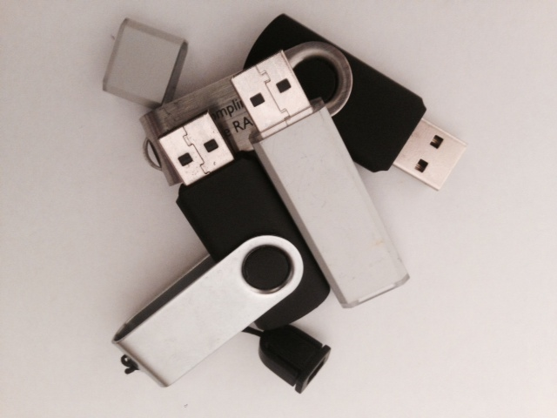
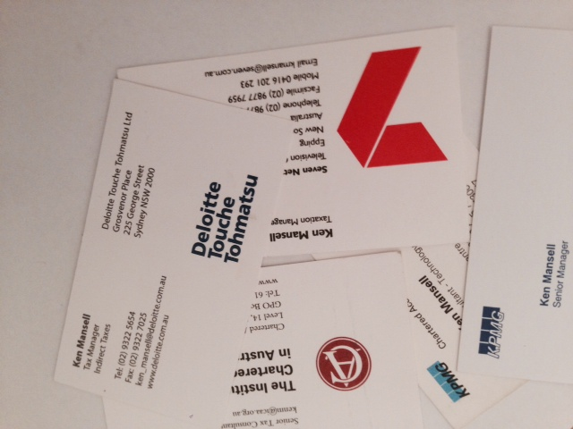
  Small Business CGT
Why even consider this?
SUPERANNUATION
New rules, especially $1.6m+ no non concessional…

Slide 16
  Small Business CGT
Active assets
Small business entity or $6m MNAT
Right ownership
  SIs at 20% or partner of SI
  8 SIs each gets $500k or 15 years

Slide 17
  Small Business CGT
15 years
    Over 55 and retirement
$500 lifetime
  Under 55 must go to super

Slide 18
  What about this
  Chris and Vicky establish a new discretionary trust, lend the trust $600,000 (which they borrow from the bank) and the trust purchases the land and building off the company, the company has a $350,000 capital gain
  Stamp duty issues.
  The company could opt not to apply the small business restructure rollover, but rather apply the $500,000 lifetime concession.
Notes:
Tips:
The New Slide button is on the Standard toolbar.
You can also click Insert>New Slide.

Slide 19
  What about this
  The company is required to pay $175,000 to Chris and the same to Vicky. Given their age this amount has to be put into super, so the super fund now has an additional $350,000.
  The company still holds $250,000 of the $600,000 paid to it by the trust. It could pay this out as a dividend and, after top up tax is paid, Chris and Vicky could contribute this as concessional contributions over the next few years (5+).
Notes:
Tips:
The New Slide button is on the Standard toolbar.
You can also click Insert>New Slide.

Slide 20
  What about this
  Asset protection
  Income splitting
  Future CGT concessions
  Lots more super…
  What do you think? Is it worth it.
Notes:
Tips:
The New Slide button is on the Standard toolbar.
You can also click Insert>New Slide.

Slide 21
  Why didn’t you lodge your returns?
  “I couldn’t complete my tax return, because my husband left me and took our accountant with him. I am currently trying to find a new accountant…”
Notes:
Tips:
The New Slide button is on the Standard toolbar.
You can also click Insert>New Slide.

Slide 22
Ken Mansell
ken@taxrambling.com
taxrambling.com
Small Business Restructures & Super

